Slide 1

NETFLIX DATA ANALYSIS
VAISHAK VT
APPLY_1754994345689b16a9c4087

Slide 2

PROBLEM STATEMENT
Netflix has a vast library of Movies and TV Shows, but with growing competition, it is important to analyze content trends.
This project studies Movies vs TV Shows, genres, and country contributions to provide data-driven insights for strategic content decisions.

Slide 3
Project Description
This project analyzes a Netflix dataset containing 7,789 records of Movies and TV Shows from 2008 to 2021. The goal is to uncover content trends and provide strategic insights for decision-making.
Key aspects studied include:
Distribution of Movies vs TV Shows over the years.
Most popular genres and their evolution.
Country-wise contributions to understand global representation.
Top directors and actors driving content production.
Identification of gaps and opportunities for future content strategy.
By combining data analysis and visualization, the project helps Netflix understand audience preferences, optimize content acquisition, and strengthen its competitive edge in the global OTT market.

Slide 4

WHO ARE THE END USERS?
🎯 Netflix Content Strategy Team – to identify content gaps, audience trends, and make data-driven production or acquisition decisions.
📈 Data Analysts & Business Intelligence Teams – to track performance metrics, visualize content trends, and generate insights.
🎬 Marketing & Regional Teams – to plan promotions and regional content strategies based on country-wise audience preferences.
🧠 Researchers & Students – to explore OTT data patterns and understand real-world data analysis applications.

Slide 5

Technology Used
🐍 Python – for data cleaning, analysis, and visualization.
📊 Pandas & NumPy – to manipulate, transform, and aggregate Netflix data efficiently.
📈 Matplotlib & Seaborn – to create insightful visualizations of content trends.
☁️ Jupyter Notebook – for coding, documenting, and interactive data exploration.
💾 CSV Dataset – as the primary data source for Netflix content information.
🧠 WordCloud Library – to visualize genre and keyword frequency patterns.

Slide 6
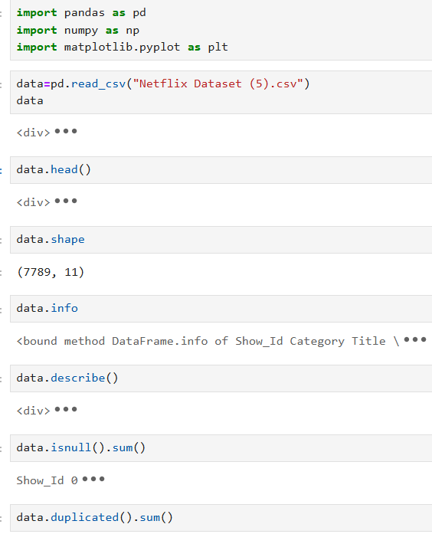
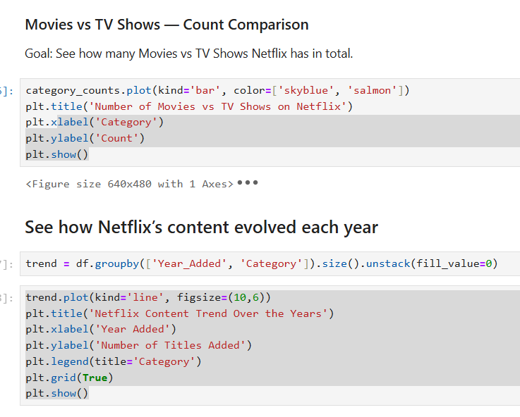
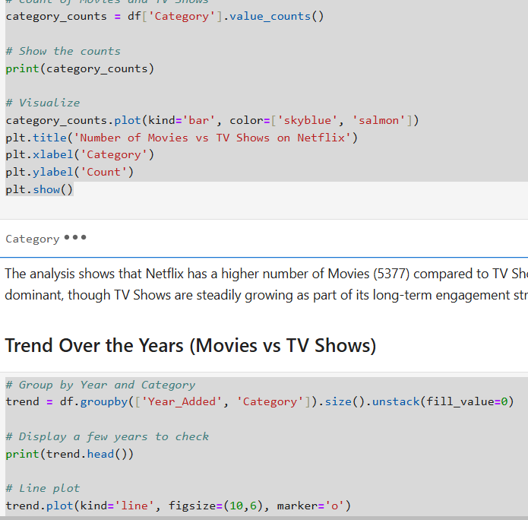
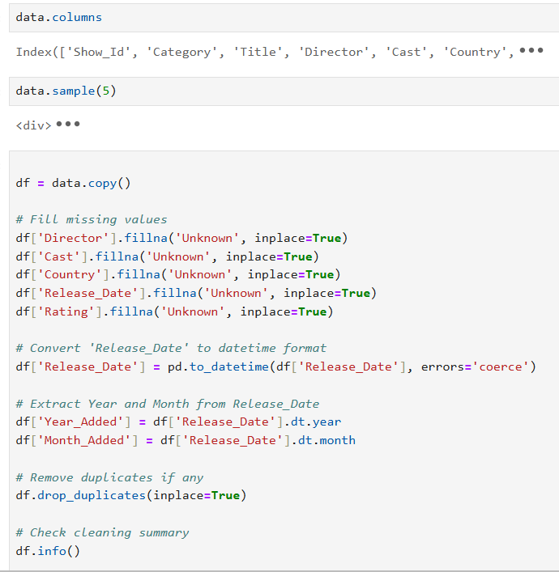
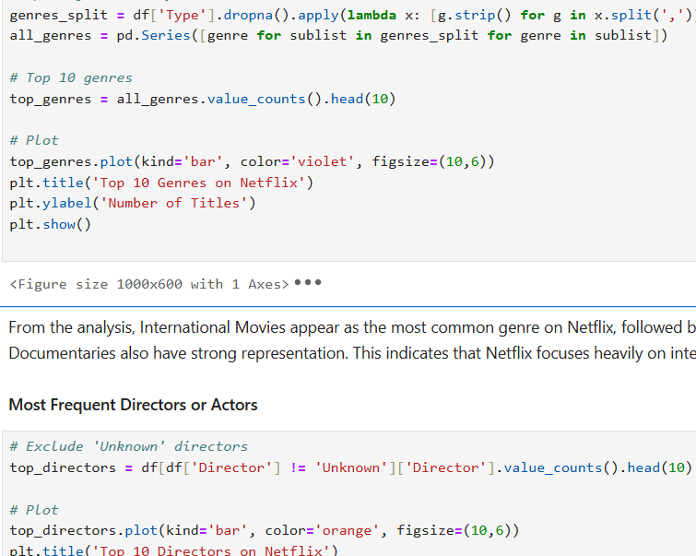
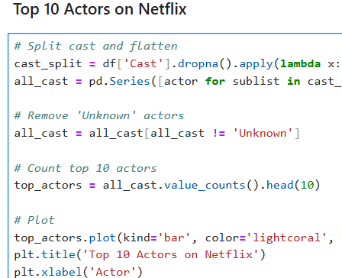
RESULTS1
[Ad screen shots of your code or Chart(s) ]

Slide 7
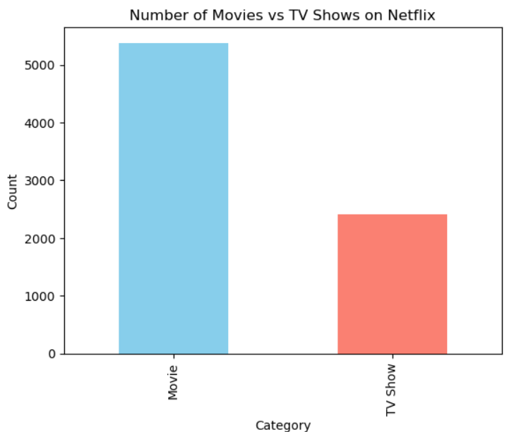
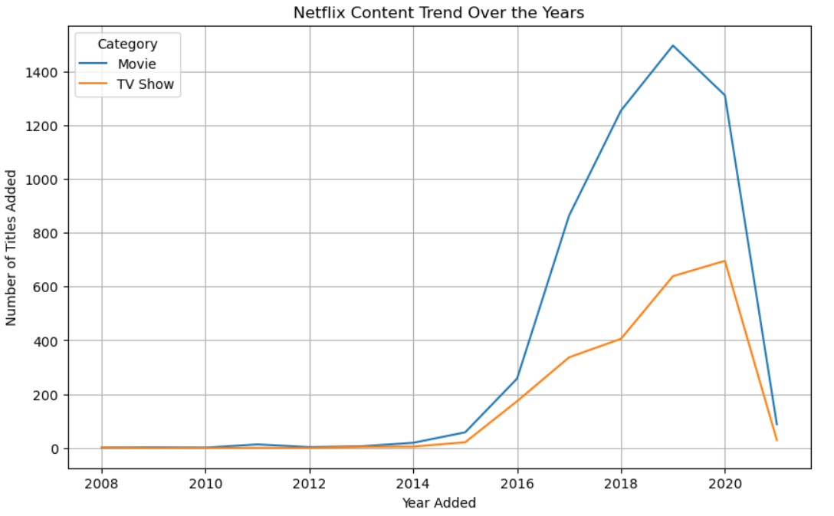
RESULTS 2

Slide 8
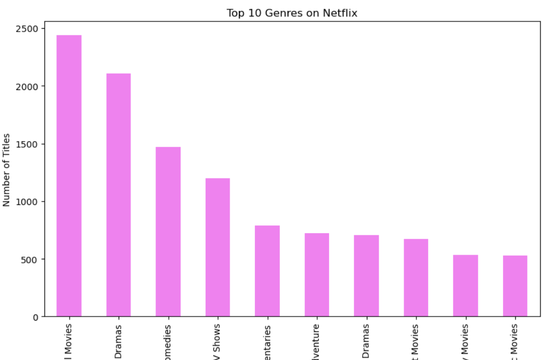
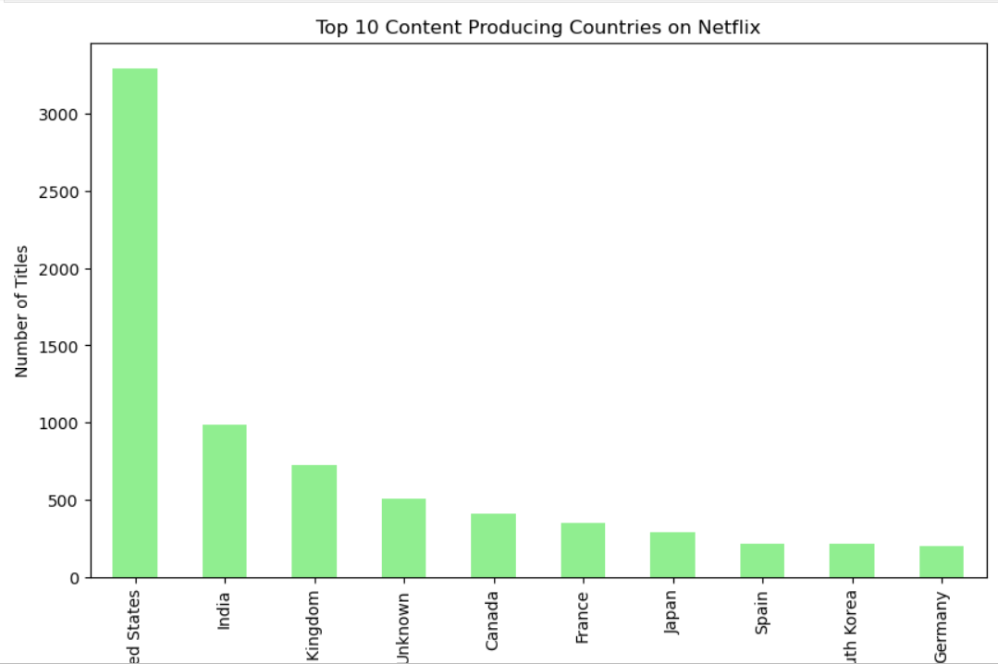
RESULTS 3

Slide 9
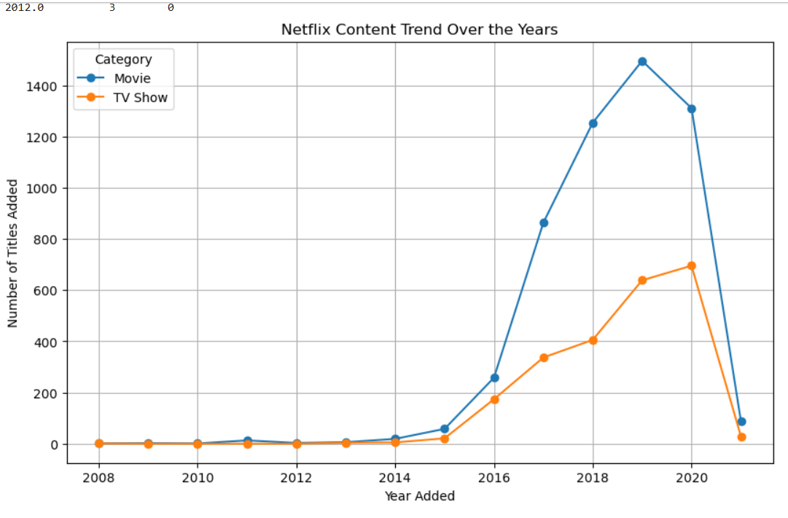
RESULTS 4

Slide 10
GitHub repository
https://github.com/vaishakvt/VOIS_AICTCE_Oct2025_MajorProject_Vaishak_vt

Slide 11
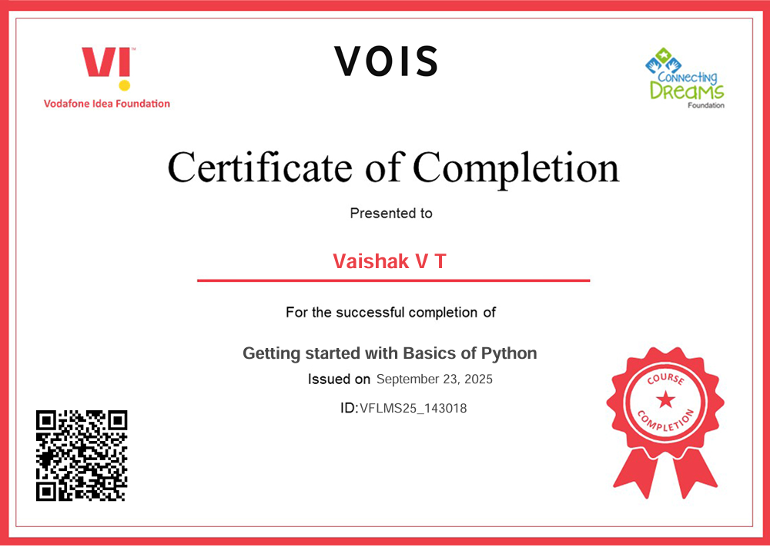
Getting started with Basics of Python Certificate

Slide 12
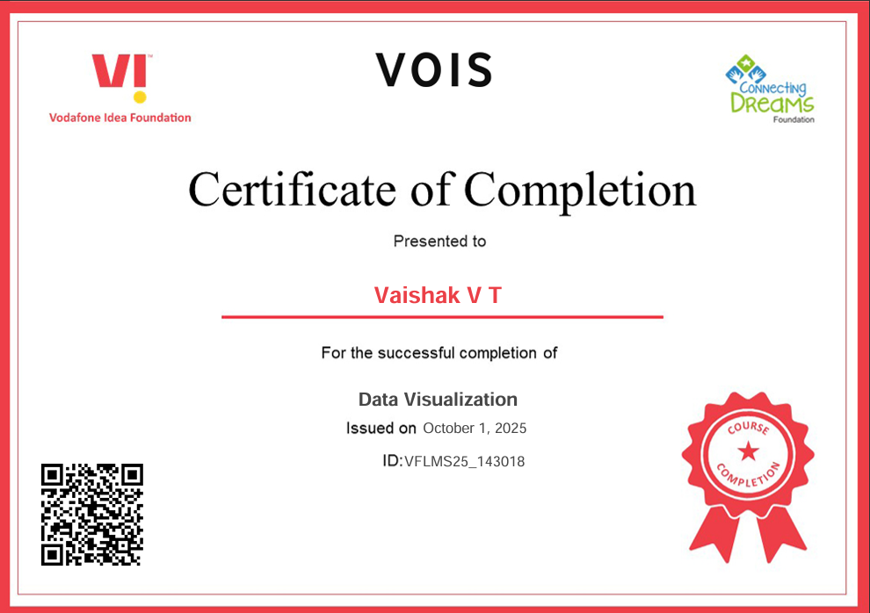
Data Visualization Certificate
[Paste your

Slide 13
Thank you
.
.

